Slide 1
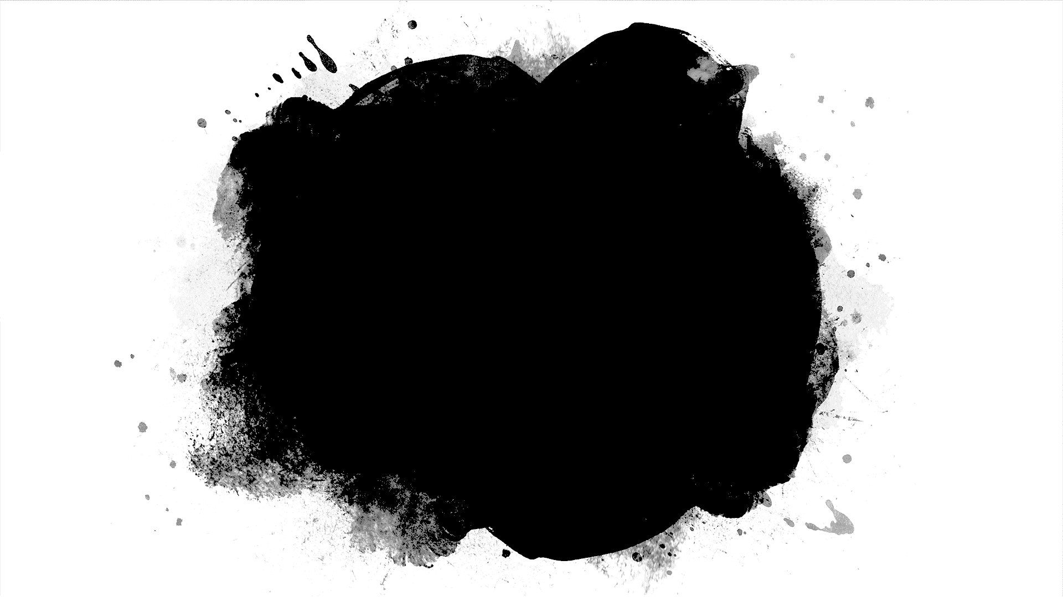
DriverPass System Analysis
Seth Mascho
Notes:
[No speaker notes required for this slide.]

Slide 2
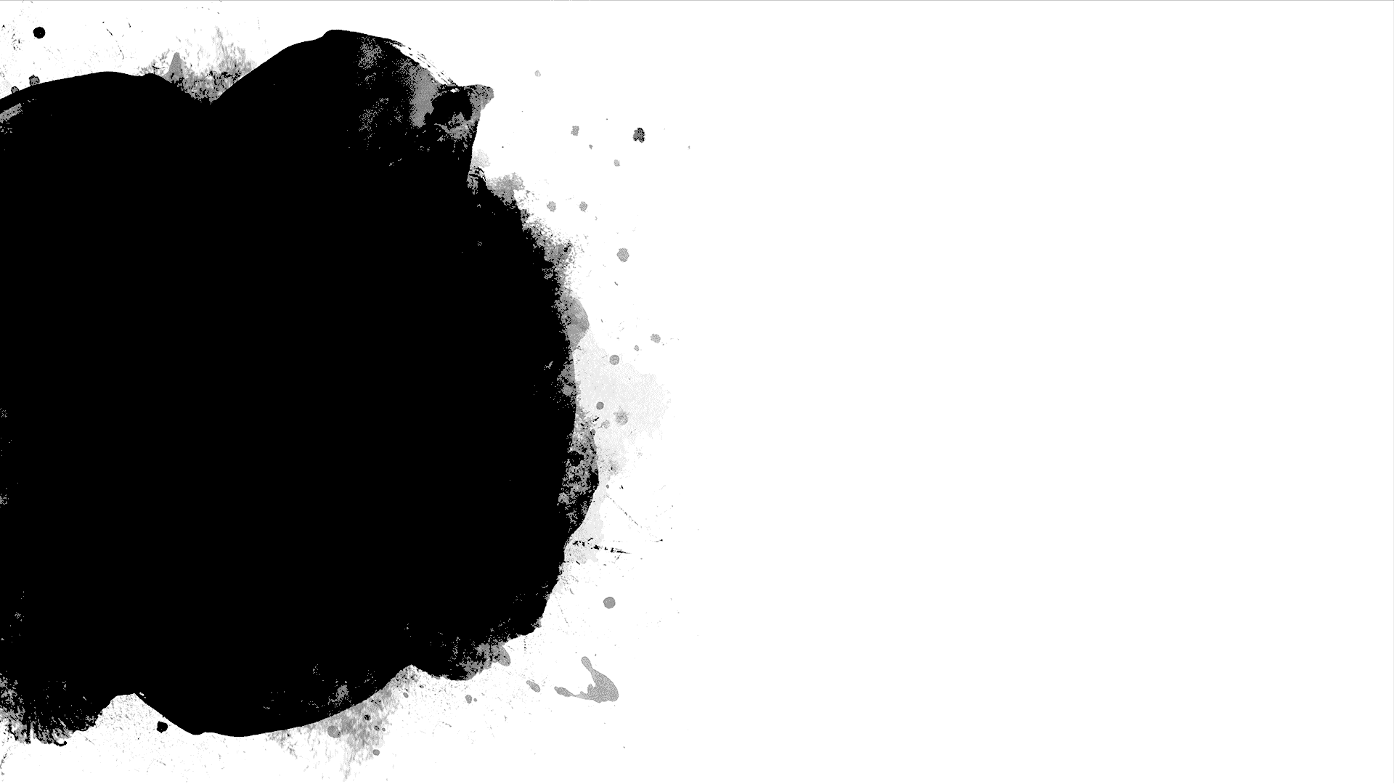
System Requirements
Functioning requirements
The system shall allow users to edit their reservation.
The system shall allow IT personnel full access to the backend systems
Nonfunctioning requirements
Different levels of user authentication, customer, secretary, IT and boss.
Notes:
For this system to do as it is supposed to, users need to be able to create and manage their reservations. The IT personnel need to be able to access the backend in case anything needs to be fixed or updated.
The nonfunctional requirements are different levels of user security, and for the system to run off webservices, such as the cloud.

Slide 3
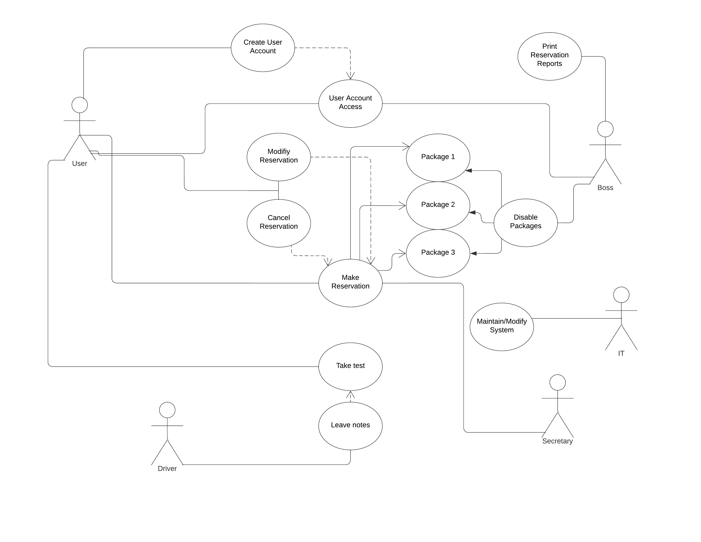
Use Case Diagram
Notes:
There are 4 main different actors that access the system are The Customer, The IT Personnel, The Secretary and The Boss. The Customer uses the system to create an account, and make reservations, view/cancel them and see test results. The Boss can Disable and Enable driver packages, they can make changes to user accounts and see recent reservations. Everything that a user should be able to do is accounted for from the ability to create reservations to delete user accounts.

Slide 4
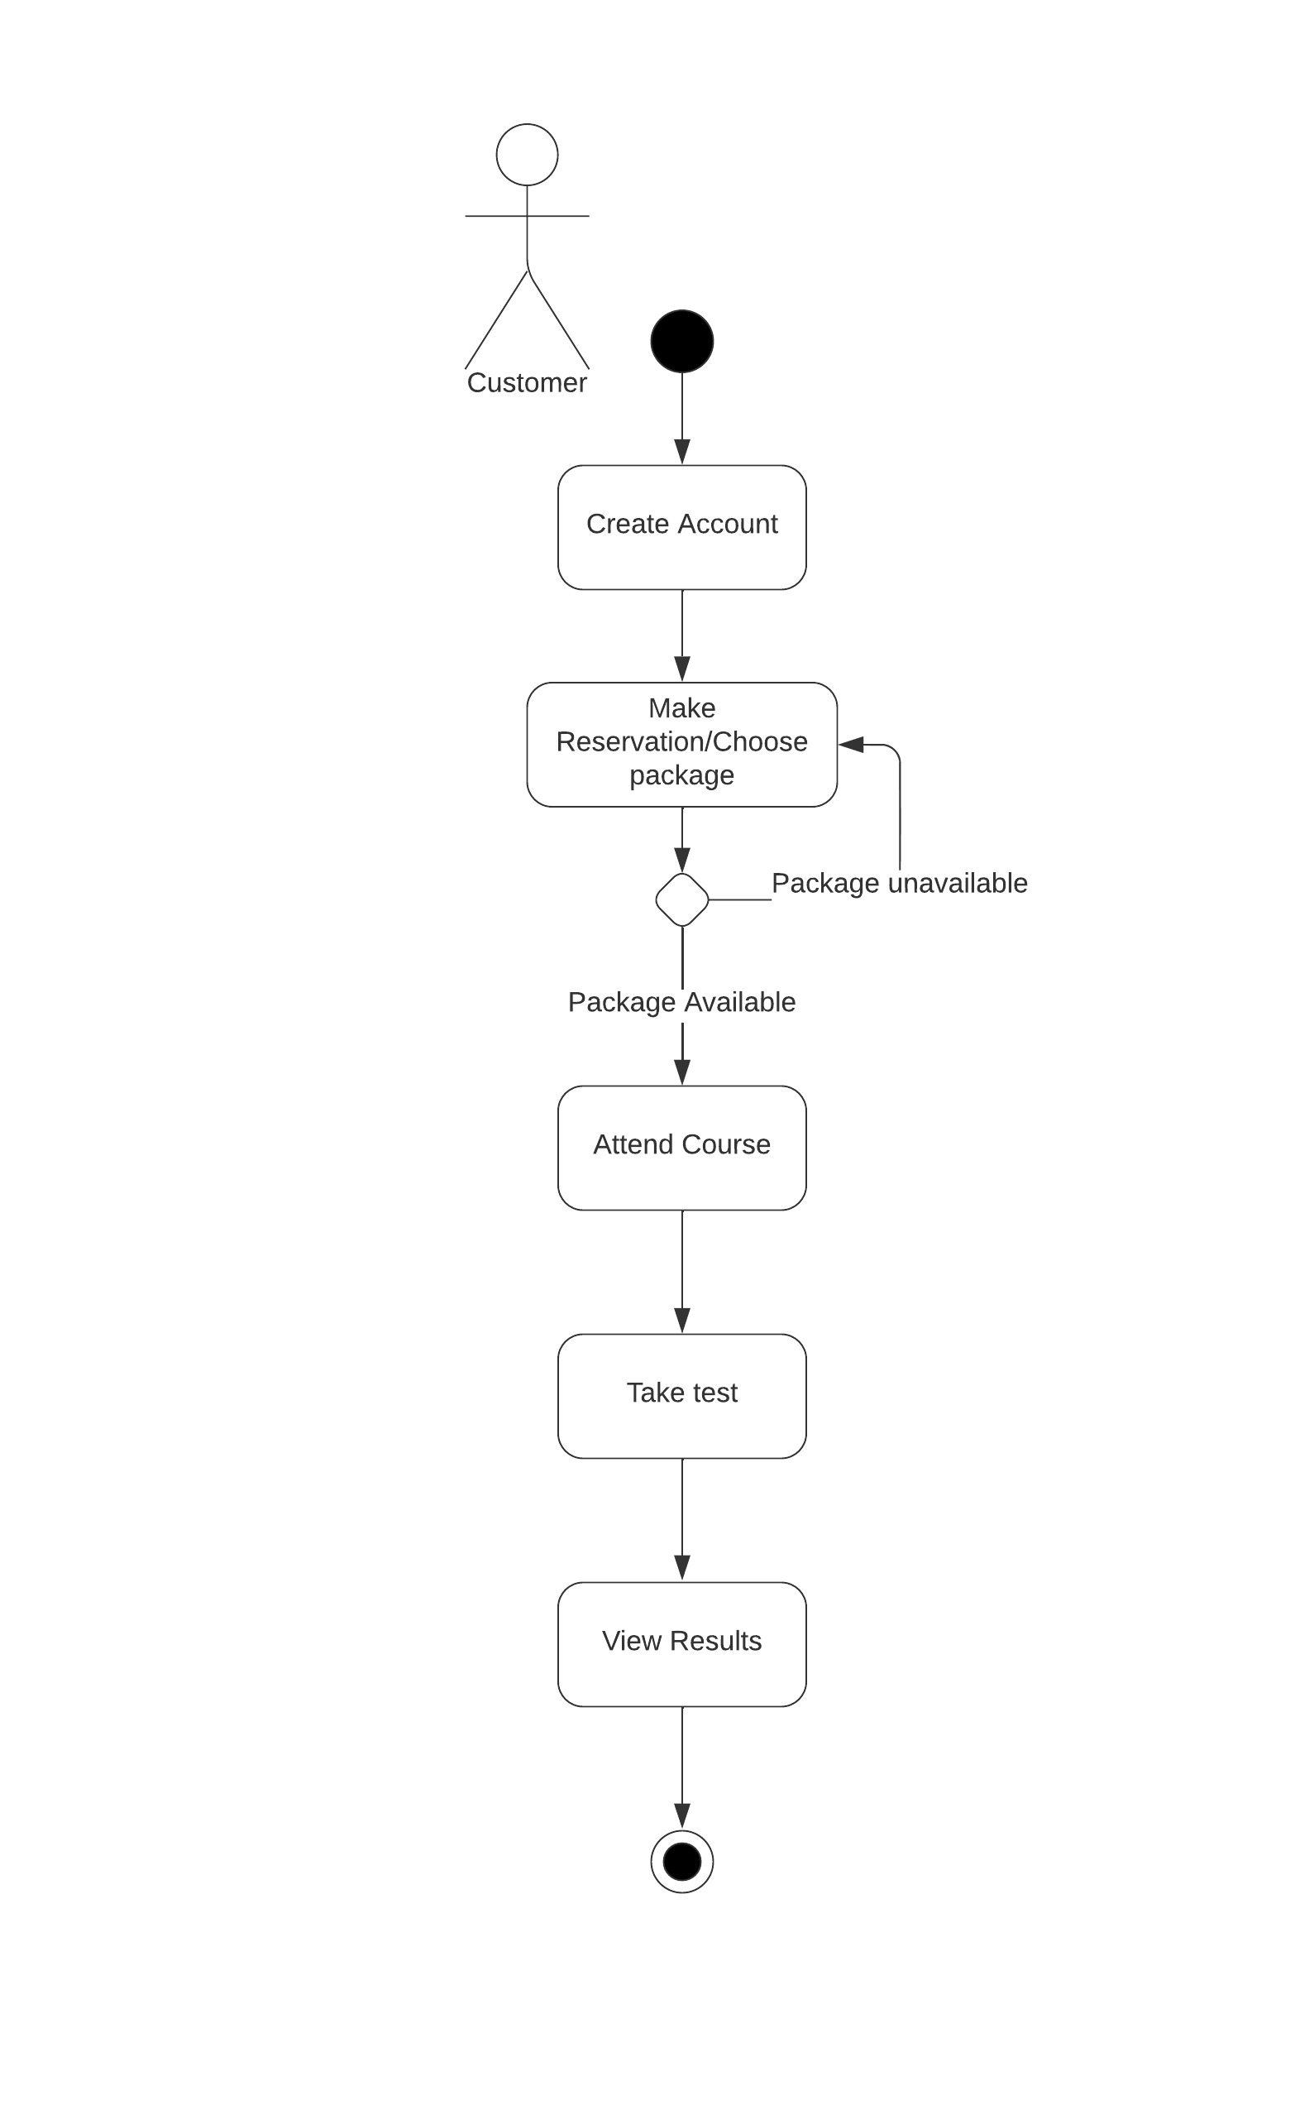
Activity Diagram
Notes:
The users use case is being broken down. The steps are for creating accounts, making/modifying/canceling reservations and viewing test results. DriverPass needs its customers to be able to properly reserve drive tests and make any changes.

Slide 5
Security
There will be 4 levels of user security
Customer
Secretary
IT
Boss
Notes:
There isn’t any additional security to this system. How the user account details are stored isn’t stated, same as security questions.

Slide 6
System Limitations
The system is incredibly simple, meaning it lacks a lot of quality-of-life improvements.
Lack of additional security could mean user data is easily stolen.
There aren’t any restrictions for passwords.
Everything seems to be updated by the workers of DriverPass.

